Slide 1


M.Tech Program
Advanced Industry Integrated Programs
Jointly offered by University and LTIMindTree
Project Title
Agentic AI Multi-Agent Architecture for Automated Fake News Verification & Explainable Trust Assessment
Team Member
VINOTH KANNA S
CRESCENT 2025-27
Knowledge partner | Implementation partner

Slide 2

Agentic AI Multi-Agent Architecture for Automated Fake News Verification
Introduction
Fake news spreads rapidly through social media and digital platforms.
Traditional fact-checking is slow and difficult to scale.
Existing AI models often give results without clear reasoning.
This project uses Agentic AI to verify claims, collect evidence, and provide an explainable trust score.

Slide 3
Agentic AI Multi-Agent Architecture for Automated Fake News Verification
Objective
Build a Multi-Agent System – Use Claim Extraction Agent, Evidence Retrieval Agent, Source Credibility Agent, Cross-Reference Agent, and Verdict Agent for automated fact-checking.
Verify Claims – Analyze evidence and source credibility through cross-checking.
Generate Trust Scores – Provide explainable trust scores with confidence levels.
Reduce Bias & Ensure Auditability – Use self-checking and maintain an evidence trail.

Slide 4
Agentic AI Multi-Agent Architecture for Automated Fake News Verification
Modules to cover
Module Name | Subtopic
Claim Extraction Module | Parsing input into atomic, checkable claims; separating fact from opinion; detecting implicit/misleading framing
Context & Provenance Module | Tracing content origin, publisher history, reverse-image/video matching, manipulation detection
Evidence Retrieval Module | Querying search engines and fact-check databases per claim; retrieving both supporting and contradicting evidence
Source Credibility Module | Scoring sources on accuracy track record, editorial transparency, and domain reputation
Cross-Referencing Module | Comparing claims against evidence; classifying support/contradict/unverifiable; detecting logical fallacies
Linguistic & Behavioral Signal Module | Detecting emotional manipulation, clickbait, false urgency as supplementary risk indicators
Adversarial Review Module | Devil's-advocate agent that challenges the draft conclusion to surface weak reasoning
Trust Aggregation Module | Combining all signals via a transparent weighted rubric into a final trust score with confidence interval
Explainability & Reporting Module | Generating human-readable rationale, evidence citations, and audit trail for every verdict

Slide 5
Methodology
1
Evidence Over Assertion
2
Specialized Agents
The pipeline never guesses truth directly. It gathers real, citable evidence from independent sources and scores that evidence instead.
Each pipeline stage - ingestion, search, scoring, explanation - is an independent, single-purpose agent with its own inputs, outputs, and failure handling.
3
Transparent, Weighted Rubric
4
Explainable by Design
A composite 0-100 Trust Score is built from four weighted factors: Source Evidence (40%), Content Consistency (25%), Media Authenticity (20%), Fact-Check Alignment (15%).
Every verdict ships with its factor breakdown, matched sources, and a plain-language AI summary - never a bare true/false label.

Slide 6
Approach, Algorithms & Tools
1
Agents & Algorithms
2
External Data Sources
3
Core Tech Stack
IngestionAgent
Text / URL / audio parsing + claim extraction
SerpAPI
Google Fact Check engine + web fallback
Backend
FastAPI, SQLAlchemy, SQLite, JWT auth, rate limiting
SearchAgent
Parallel multi-source retrieval, de-dup & trusted-source ranking
NewsAPI + GNews
Two independent news search providers
Orchestration
Python asyncio - agents run concurrently, not in series
AudioAnalysisAgent
Caption & object detection; transcription + confidence signals
Wikipedia
General web & background evidence
Frontend
React, TypeScript, Tailwind CSS
TrustScoringAgent
Weighted rubric -> 0-100 score & verdict
HuggingFace (optional)
Image captioning & object detection
Voice Input
Web Speech API (speak-to-search)
ExplanationAgent
LLM-generated summary & recommendations
AssemblyAI
Audio transcription
Export
Server-rendered PDF verification reports
Groq (Llama 3.3 70B)
Narrative summarization

Slide 7
Pipeline Structure
Input
Text · URL · Image · Audio
IngestionAgent
Extract text & candidate claims
Audio Analysis Agent
Runs only for audio input
SearchAgent
SerpAPI · NewsAPI · GNews · Wikipedia (parallel)
TrustScoringAgent
Weighted rubric -> Trust Score + Verdict
ExplanationAgent
Groq LLM -> summary + recommendations
Result
Saved to SQLite - rendered as score, factors & sources

Slide 8
Agentic AI Multi-Agent Architecture for Automated Fake News Verification
Project Plan: Milestones & Progress
Phase 1 - Core Verification Pipeline COMPLETED
✓
Ingestion, Search, Trust Scoring & Explanation agents; end-to-end text/URL verification with a transparent factor breakdown.
Phase 2 - Multi-Modal & Accounts COMPLETED
✓
Image & audio verification, JWT auth with guest mode, history dashboard, PDF report export.
Phase 3 - Data Completeness Fixes COMPLETED
✓
Media-analysis findings & AI summary reliably surfaced in the UI; voice ("speak-to-search") input.
Phase 4 - Evidence Quality Upgrade COMPLETED
✓
Second independent news source (GNews), 20-outlet trusted-publisher prioritization, "Detected Source" attribution UI, automatic DB migrations.
Phase 5 - Planned Next PLANNED
Broader fact-check/language coverage, production deployment, and structured user testing.

Slide 9
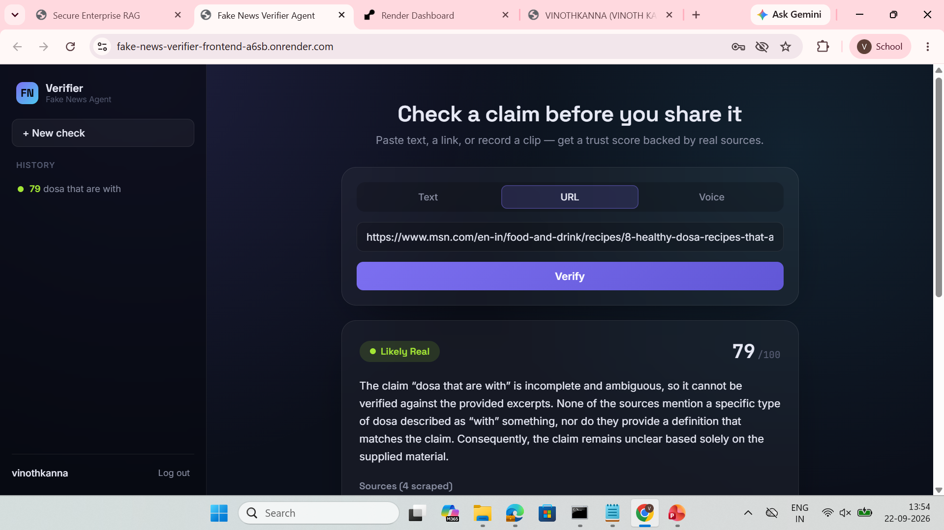
Result: Under Testing

